Slide 1
The Importance of Using Units,
a trivial PowerPoint for serious people.
Michael C. Sitarz, Ph. D.

Slide 2
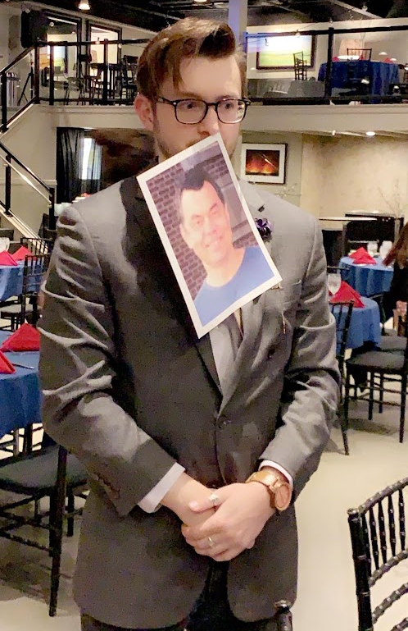
Who am I?
University of Alabama (2013 – 2017)
  Bachelors in Physics and Bachelors in Math under Jeremy Bailin (Dark Matter Halo Evolution)
KU Physics and Astronomy Graduate Student Aug. 2018 – May 2024
  PhD under Misha V. Medvedev (Astrophysical Plasma Instabilities and Cascades)
  MSc under Sergei F. Shandarin (Dark Matter Caustics)
Assistant Professor of Physics at Baker University (Aug. 2024)

Slide 3
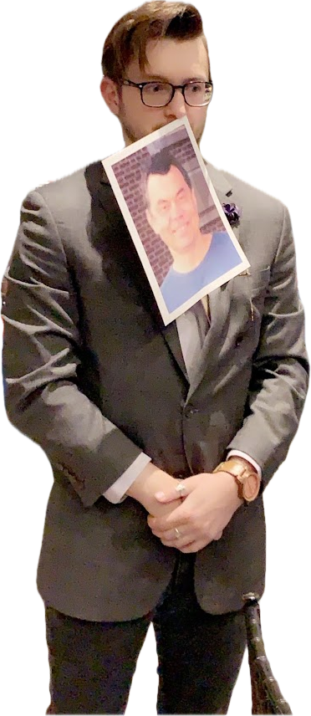
What do you Do?
The Second Advisor
  A graduate school tale as old as time: there was money in need of a student and a student in need of funding.
  “You work for both of us now.” - Misha V. Medvedev, 2019
Get into Graduate School
Find a PhD advisor and a project
Graduate and get a job
Cosmology project?

Slide 4
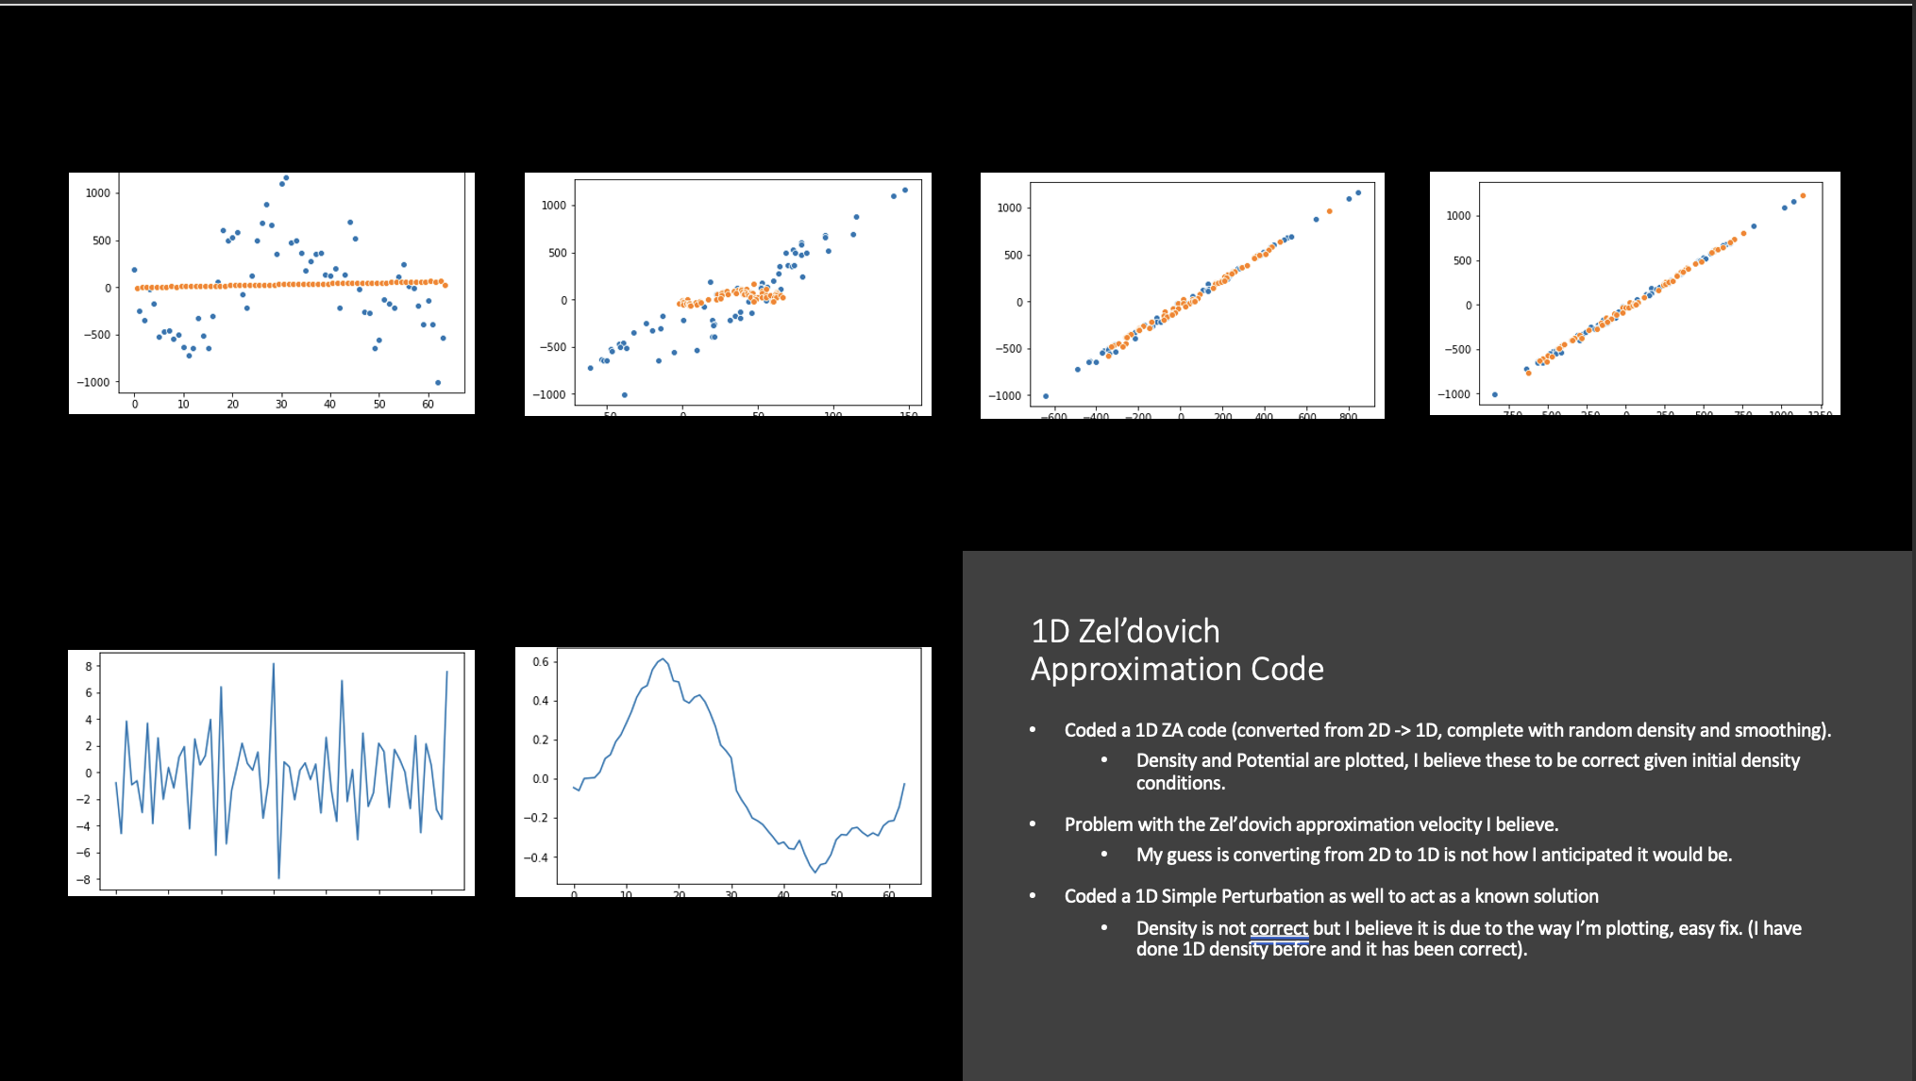
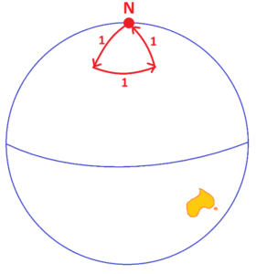
Polar Bears and Dimensions
How to be a student of Sergei F. Shandarin:
It’s a Polar Bear, duh.
Don’t. Skip. Steps.
Bring a PowerPoint.
4

Slide 5
Soviet Spaghetti Westerns
5

Slide 6

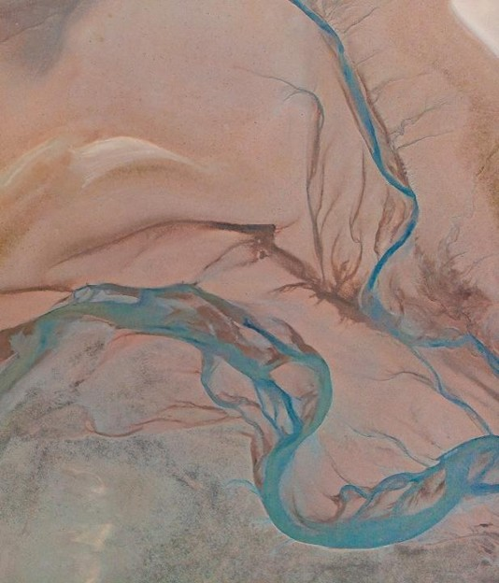
The Adventures of Dr. Shandarin: Meetings with Sergei
Social Hours
Usually 2 – 3 hours without a break.
Half of that was a retelling of The Legendarium of Shandarin.
  Gulags
  Trenches
  KGB Spaghetti
  Escaping the Soviet Union
Random Appearance at JBUG
“Ok, enough talk, its time to work.”
PowerPoints, plots, and pencils (oh my).

Slide 7
The Adventures of Dr. Shandarin: Meetings with Sergei
Social Hours
Usually 2 – 3 hours without a break.
Half of that was a retelling of The Legendarium of Shandarin.
  Gulags
  Trenches
  KGB Spaghetti
  Escaping the Soviet Union
Random Appearance at JBUG
“Ok, enough talk, its time to work.”
PowerPoints, plots, and pencils (oh my).

Slide 8
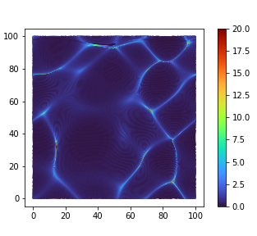

Cosmic Web Cosmology
Caustics
Simulations
The Virtual Advisor
8

Slide 9
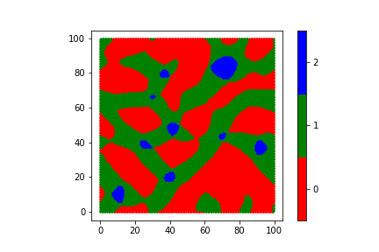
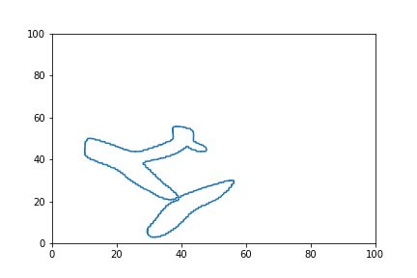
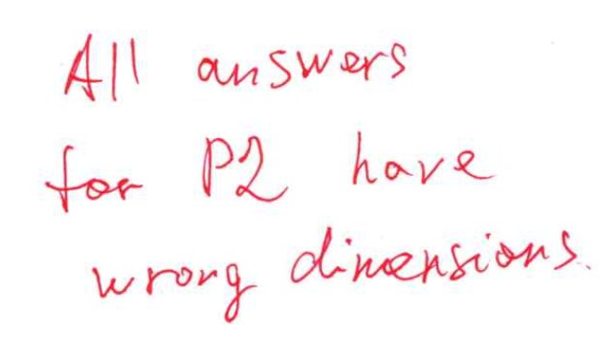

“When I left you, I was but the learner….”
Graduation: May 2024 $→$ Professor: August 2024
Teaching like Sergei
  The Importance of Using Units
The research never stops
  Students, Groups, and Dark Matter!

